Slide 1
Professional Development Training for Front-line Adult Educators
Module 1: Introduction to Micro-Learning theory
Self-directed learning resources

Slide 2
MODULE 1
This module includes 14 hours of learning content.
6 hours of F2F learning
8 hours of self-directed learning
This presentation covers the 6 hours of F2F learning.
It is accompanied by a Lesson Plan for the facilitator.
Go through the presentation with self-directed learning resources at your own pace!
Notes:
1 academic hour = 45 minutes

Slide 3
Introduction
This presentation includes self-directed learning resources and a self-reflection exercise.
Feel free to select the resources that best align with your interests and learning goals.
These resources can be explored independently, without any prescribed order or requirement to go through all of them.
Notes:
This approach allows learners to engage with multiple perspectives and examples related to the overview and definition of Microlearning, offering a comprehensive understanding of the concept.

Slide 4
I. Introduction to Microlearning
1. Overview and Definition of Microlearning
Notes:
Dive into the core concepts of Microlearning with this video. It explores the definition, significance, and key characteristics of Microlearning in a concise format.

Slide 5
I. Introduction to Microlearning
1. Microlearning Examples
Notes:
Explore real-world examples and applications of Microlearning through this video. Witness how various industries utilize Microlearning to enhance learning outcomes.

Slide 6
I. Introduction to Microlearning
2. Microlearning: Why it matters
Notes:
Gain deeper insights into Microlearning's significance and impact on learning efficiency and effectiveness through this engaging video.

Slide 7
I. Introduction to Microlearning
2. Microlearning Examples
Notes:
Explore various techniques and methods employed in Microlearning to facilitate effective and engaging learning experiences.

Slide 8
I. Introduction to Microlearning
2. Microlearning Examples
Notes:
Delve deeper into Microlearning strategies and discover how they contribute to efficient learning processes, enhancing retention and engagement.

Slide 9
I. Introduction to Microlearning
3. Benefits of Microlearning
Notes:
Explore the practical aspects of implementing Microlearning in training contexts and its impact on learner engagement and knowledge retention

Slide 10
I. Introduction to Microlearning
4. Microlearning Best Practices
Notes:
Discover best practices in Microlearning design and delivery, ensuring an effective learning experience for learners.

Slide 11
II. Adult Learning Theory
1. Andragogy vs. Pedagogy
Notes:
Dive into the principles and characteristics of Adult Learning Theory through this video. Explore how adults learn best and the implications for instructional design.

Slide 12
II. Adult Learning Theory
2. Applying Adult Learning Principles to Microlearning
Notes:
Learn about practical applications of Adult Learning Theory in educational settings. Understand how educators can leverage these principles for effective teaching.

Slide 13
II. Adult Learning Theory
2. Using Adult Learning Principles to Create Effective Training
Notes:
Explore real-life examples and case studies illustrating the application of Adult Learning Theory in various learning environments. Understand its impact on learning outcomes.

Slide 14
III. Designing Effective Microlearning Modules
1. Storytelling in Microlearning
Notes:
Explore essential strategies and techniques for designing effective Microlearning modules in this insightful video.

Slide 15
III. Designing Effective Microlearning Modules
2. Gamification in Microlearning
Notes:
Learn about visual design principles tailored for Microlearning content creation, enhancing learner engagement and comprehension.

Slide 16
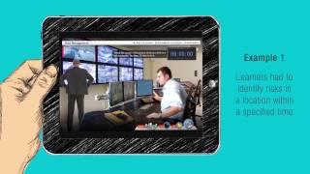
III. Designing Effective Microlearning Modules
3. How to create Engaging Compliance courses using Gamification and Microlearning
Notes:
Dive into the creation of interactive Microlearning modules, discovering effective methods to engage learners dynamically.

Slide 17
III. Designing Effective Microlearning Modules
3. How to create Engaging Online Compliance
Notes:
Explore content chunking strategies specifically tailored for Microlearning, enabling effective knowledge absorption in bite-sized formats.

Slide 18
III. Designing Effective Microlearning Modules
4. Micro-Learning: An important tool in your learning content strategy
Notes:
Understand effective assessment methods and strategies suitable for evaluating learning outcomes in Microlearning modules.

Slide 19
IV. Delivery Methods
1. Technology and Platforms
Notes:
Explore various effective delivery methods tailored for Microlearning, understanding how different approaches enhance learning engagement and retention.

Slide 20
can you provide me some simple self reflection questions after this self directed learning module?
V. Assessment and Evaluation
1. Methods for measuring the effectiveness of microlearning
Notes:
Dive deeper into specific delivery strategies used in Microlearning, discovering methods to optimize content delivery for diverse learner needs.

Slide 21
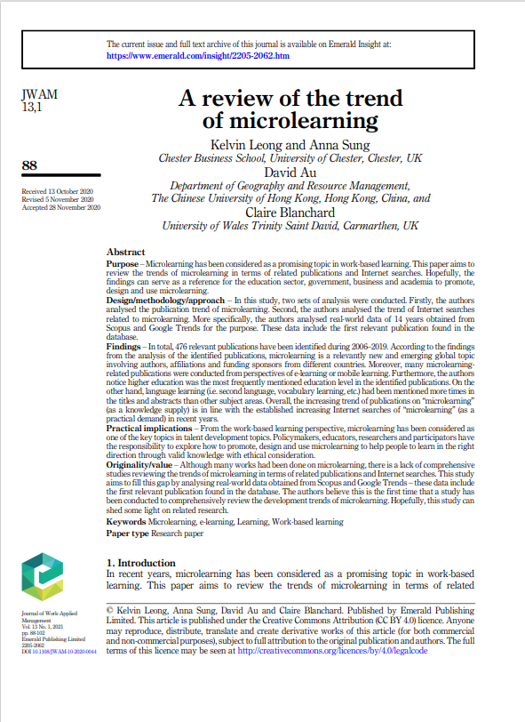
can you provide me some simple self reflection questions after this self directed learning module?
ARCTICLES
1. A review of the trend of microlearning - link
(approx. 45 min reading)
Notes:
Explore insights into Microlearning methodologies and their effectiveness in enhancing learning outcomes.

Slide 22
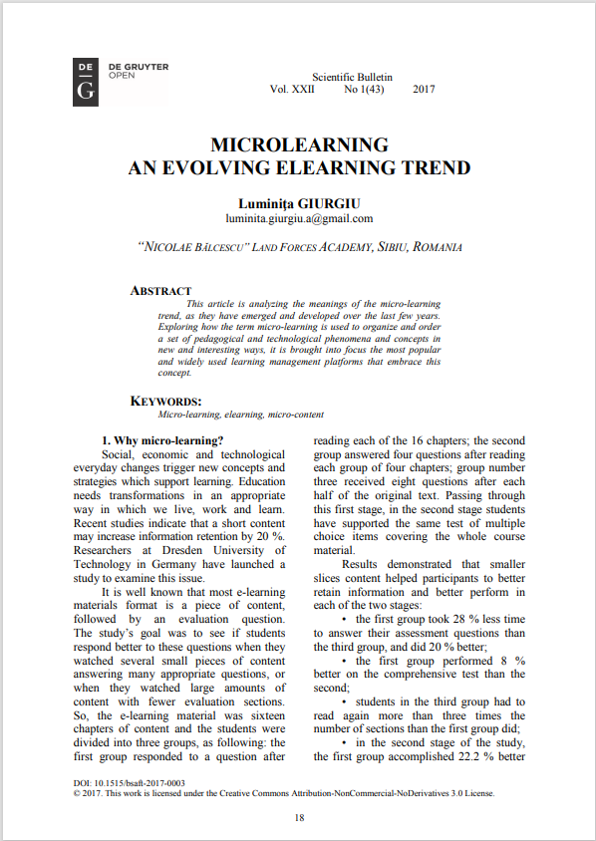
can you provide me some simple self reflection questions after this self directed learning module?
ARCTICLES
2. MICROLEARNING: AN EVOLVING ELEARNING TREND - link
(approx. 30 min reading)
Notes:
Delve into the application of Microlearning in the context of skill development, understanding its impact on skill acquisition.

Slide 23
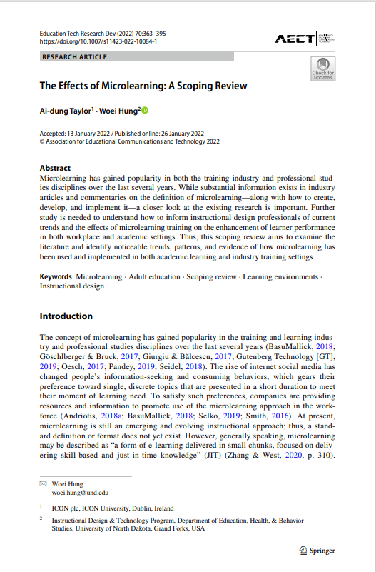
can you provide me some simple self reflection questions after this self directed learning module?
ARCTICLES
3. The Effects of Microlearning: A Scoping Review - link
(approx. 1 hour reading)
Notes:
Explore the role of technology in facilitating effective Microlearning experiences, highlighting its influence on engagement and retention.

Slide 24
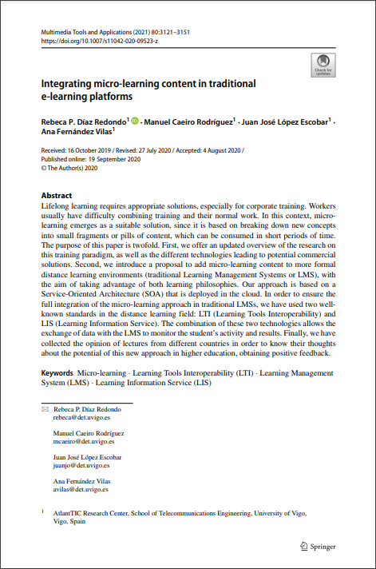
can you provide me some simple self reflection questions after this self directed learning module?
ARCTICLES
4. Integrating micro-learning content in traditional e-learning platforms - link
(approx. 1 hour reading)
Notes:
Investigate the multimedia aspects and their impact on the design and delivery of Microlearning content.

Slide 25
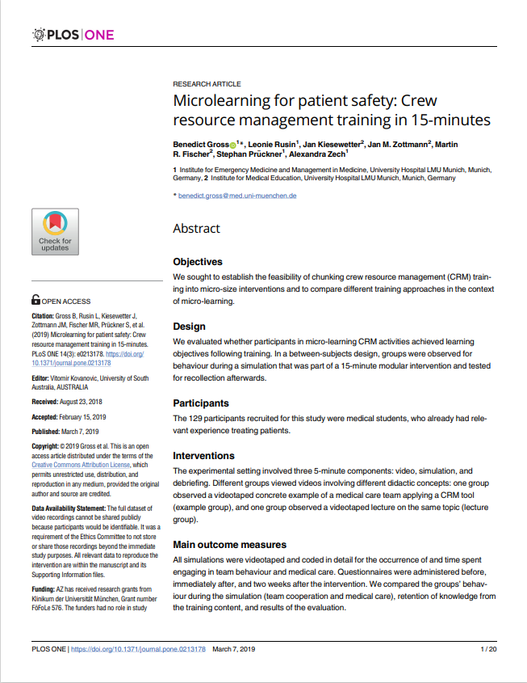
can you provide me some simple self reflection questions after this self directed learning module?
ARCTICLES
5. Microlearning for patient safety: Crew resource management training in 15-minutes - link
(approx. 45 min reading)
Notes:
Examine the effectiveness of Microlearning in healthcare education, emphasizing its role in improving learning efficiency in the medical field.

Slide 26
Self-reflection questions
These reflection questions can assist you in summarizing your knowledge, pinpointing areas where you can enhance your skills, and strategizing how to employ microlearning techniques more proficiently in the realm of adult education
1. What key concepts and principles of microlearning have I learned during this module?
2. How do these concepts align with my previous understanding of adult education and learning theories?
3. What specific benefits of microlearning in adult education did I find most compelling, and why?
4. Have I been able to apply any of the microlearning techniques I learned to my own educational context or work? If so, what were the results?

Slide 27
Self-reflection questions
5. Have I been able to apply any of the microlearning techniques I learned to my own educational context or work? If so, what were the results?
6. What are some examples from the module that stood out to me, and how might I adapt or apply similar strategies in my own practice?
7. How have my views on adult learning theory evolved or deepened as a result of this learning experience?
8. How can I integrate microlearning principles into my ongoing professional development and adult education initiatives?

Slide 28
Conclusion
Thank you for going through these self-directed learning activities.
If you enjoyed this module, we recommend you to explore other ONE STEP UP resources.

Slide 29
THANK YOU!

Slide 30
“The European Commission’s support of this publication does not constitute an endorsement of the contents, which reflect the views only of the authors, and the Commission can not be held responsible for any use which may be made of the information therein.”
Project Number: 2022-1-LT01-KA220-ADU-000085898

