Slide 1
Professional Development Training for Front-line Adult Educators
Module 3: Introduction to Engagement Strategies in Digital Environments

Slide 2
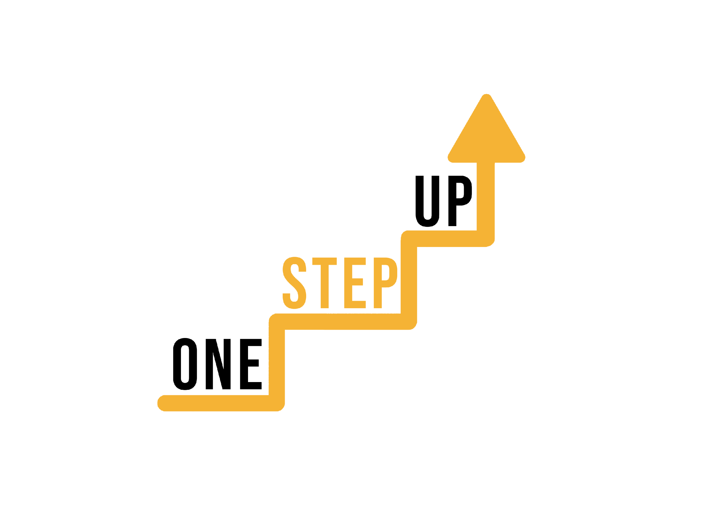
MODULE 3
This module includes 14 hours of learning content.
6 hours of F2F learning
8 hours of self-directed learning
This presentation covers the 6 hours of F2F learning.
It is accompanied by a Lesson Plan for the facilitator.
Go through the presentation with self-directed learning resources at your own pace!
Notes:
1 academic hour = 45 minutes

Slide 3
Session 1: Introduction to Engagement in Digital Environments
Session 2: Designing Engaging Learning Experiences;
TABLE OF CONTENT
Session 3: Communication and Interaction;
Session 4: Gamification and Motivation
Session 5: Assessment and Feedback
Session 6: Adapting Engagement Strategies
FAQ, Evaluation and Conclusion

Slide 4
Session 1:
Introduction to Engagement in Digital Environments
Notes:
Allocated time: 30 minutes

Slide 5
INTRODUCTION
The purpose of the workshop: to explore engagement strategies in digital learning environments.
Specific objectives for this session:
- Understand the significance of engagement in digital learning.
- Identify challenges and opportunities related to engagement.
Interactive nature of the session - active participation is important!

Slide 6
The evolving role of educators reflects the shift from information delivery to skills cultivation; Primary role for educator is now to foster critical thinking, problem-solving, and adaptability in students.
More about digital environments (EN): https://www.youtube.com/watch?v=-7UI-dTbMr0
Engagements in Digital Environments can help adult educators cultivate needed skills and reach the adults that doesn’t have well enough accessibility to the educational system.

Slide 7
Icebreaker – "Two Truths and a Lie"
Instruct each participant to think of two true statements and one false statement about themselves related to digital technology or online learning.
Participants take turns sharing their statements, and the rest of the group guesses which statement is the lie.
This activity encourages engagement, introduces participants, and adds an element of fun.
Notes:
Allocated time: 30 minutes
This icebreaker will not only help participants to get familiar with digital tools that they can use for creating micro-learning resources, but also to encourage team building and communication skills.
Use this list of digital tools, platforms, or apps. Each team should receive at least 3 items.
Articulate 360
Adobe Captivate
Camtasia
H5P
iSpring Suite
Canva
Kahoot
Quizlet
Genially
Mentimeter
Elucidat
Easygenerator
Lectora Inspire
EdApp
Docebo Content Creator
WizIQ
Powtoon
Vyond
Prezi
Animaker

Slide 8
Significance of engagement in digital learning
Digital learning is a powerful tool that can empower hard-to-reach adult learners to overcome challenges, build skills, and realize their full potential. It serves as a bridge between their unique circumstances and the transformative opportunities that education can provide
Motivation and Persistence
Skill Development and Application
Overcoming Barriers
Relevance and Personalization
Flexibility and Accessibility
Digital Literacy Enhancement
Cultivating a Learning Community
Empowerment and Ownership
Notes:
Allocated time: 30 minutes
This icebreaker will not only help participants to get familiar with digital tools that they can use for creating micro-learning resources, but also to encourage team building and communication skills.
Use this list of digital tools, platforms, or apps. Each team should receive at least 3 items.
Articulate 360
Adobe Captivate
Camtasia
H5P
iSpring Suite
Canva
Kahoot
Quizlet
Genially
Mentimeter
Elucidat
Easygenerator
Lectora Inspire
EdApp
Docebo Content Creator
WizIQ
Powtoon
Vyond
Prezi
Animaker

Slide 9
Challenges
For educators:
Designing Effective Content;
Technology Issues;
Interaction and Communication;
Assessment and Feedback.
For students:
Motivation and Discipline;
Technical Challenges;
Isolation and Loneliness;
Distractions;
Time Management;
Both educators and learners can address these challenges by adopting effective strategies, such as clear communication, active participation, utilizing varied teaching methods, creating supportive learning communities, and providing timely feedback.
Notes:
Allocated time: 30 minutes
This icebreaker will not only help participants to get familiar with digital tools that they can use for creating micro-learning resources, but also to encourage team building and communication skills.
Use this list of digital tools, platforms, or apps. Each team should receive at least 3 items.
Articulate 360
Adobe Captivate
Camtasia
H5P
iSpring Suite
Canva
Kahoot
Quizlet
Genially
Mentimeter
Elucidat
Easygenerator
Lectora Inspire
EdApp
Docebo Content Creator
WizIQ
Powtoon
Vyond
Prezi
Animaker

Slide 10
Group Discussion on Challenges and Opportunities of Engagement
Make small discussion groups (3-4 members per group);
Share your insights and experiences related to engagement challenges and opportunities.
Selects a spokesperson to share key takeaways with the larger group during the summarization.
Suggestions for discussion QUESTIONS:
"What challenges have you encountered in engaging adult learners in digital settings?"
"What strategies have you found effective in promoting engagement?"
Notes:
Allocated time: 30 minutes
This icebreaker will not only help participants to get familiar with digital tools that they can use for creating micro-learning resources, but also to encourage team building and communication skills.
Use this list of digital tools, platforms, or apps. Each team should receive at least 3 items.
Articulate 360
Adobe Captivate
Camtasia
H5P
iSpring Suite
Canva
Kahoot
Quizlet
Genially
Mentimeter
Elucidat
Easygenerator
Lectora Inspire
EdApp
Docebo Content Creator
WizIQ
Powtoon
Vyond
Prezi
Animaker

Slide 11
Q&A and summarization.
Notes:
Allocated time: 30 minutes
This icebreaker will not only help participants to get familiar with digital tools that they can use for creating micro-learning resources, but also to encourage team building and communication skills.
Use this list of digital tools, platforms, or apps. Each team should receive at least 3 items.
Articulate 360
Adobe Captivate
Camtasia
H5P
iSpring Suite
Canva
Kahoot
Quizlet
Genially
Mentimeter
Elucidat
Easygenerator
Lectora Inspire
EdApp
Docebo Content Creator
WizIQ
Powtoon
Vyond
Prezi
Animaker

Slide 12
Session 2:
Designing Engaging Learning Experiences
Notes:
Allocated time: 25 minutes

Slide 13
Recap of the previous session
Digital environments
Engagement
Challenges and opportunities
THIS SESSION?

Slide 14
Fundamental principles that guide the creation of engaging learning experiences I
Interactivity: Incorporate activities that encourage participation, discussions, and hands-on learning.
Relevance: Ensure content aligns with learners' goals, needs, and real-world applications.
Adaptability: Design for diverse learning styles and preferences, accommodating different paces and formats.
Feedback: Provide timely feedback to guide learners' progress and reinforce their efforts.

Slide 15
Fundamental principles that guide the creation of engaging learning experiences II
Assessment: Incorporate assessments that reflect real-world challenges and gauge mastery.
Motivation: Use compelling narratives, visuals, and scenarios to engage learners emotionally.
Collaboration: Promote collaboration through group work, discussions, and peer learning.
Clarity: Present content clearly and concisely, avoiding unnecessary complexity.

Slide 16
Small Group Activity: Designing a Mini-Lesson
3-4 people groups (max - 8 groups in total);
8 templates for designing a mini-lesson. (Each template aligns with a specific instructional design principle);
A group designs a brief mini-lesson based on the assigned principle. Choose a topic related to hard-to-reach learners' interests and keep in mind digital environments;
Each group presents their designed mini-lesson, explaining how they applied the given instructional design principle;
Groups provide constructive feedback to each other, highlighting strengths and suggesting improvements.

Slide 17
Template 1: Relevance
Instructional Goal: Clearly state the objective of the mini-lesson.
Hook: Introduce the topic with a real-world scenario or question that captures learners' interest.
Application Activity: Include an activity where learners apply the lesson content to a practical situation.
Discussion: Encourage learners to discuss how the lesson concepts relate to their lives or experiences.

Slide 18
Template 2: Interactivity
Instructional Goal: Specify the learning outcome of the mini-lesson.
Interactive Activity: Incorporate an engaging activity that requires learners' participation, such as a group discussion, case study analysis, or interactive quiz.
Collaboration: Include a collaborative element that encourages learners to work together to solve a problem or complete a task.
Feedback: Provide immediate feedback on interactive activities to reinforce learning.

Slide 19
Template 3: Feedback
Instructional Goal: State the intended outcome of the mini-lesson.
Assessment: Include a formative assessment activity where learners can apply what they've learned.
Feedback Loop: Outline how learners will receive feedback on their assessments, either through self-assessment, peer review, or instructor feedback.
Reflection: Incorporate a section where learners reflect on their assessment results and identify areas for improvement.

Slide 20
Template 4: Adaptability
Instructional Goal: Define the mini-lesson learning objective.
Multiple Modalities: Include content in different formats (text, video, audio) to cater to various learning preferences.
Options for Exploration: Offer additional resources or optional activities for learners who want to dive deeper into the topic.
Customization: Provide learners with choices for how they approach certain parts of the lesson based on their interests or learning style.

Slide 21
Template 5: Clarity
Instructional Goal: Clearly articulate the desired learning outcome.
Simplicity: Present content in a clear and concise manner, avoiding jargon or unnecessary complexity.
Visual Aids: Incorporate visuals, such as diagrams or infographics, to illustrate key concepts.
Step-by-Step: Break down complex processes into step-by-step instructions for easy understanding.

Slide 22
Template 6: Assessment
Instructional Goal: State the mini-lesson learning objective.
Application Task: Design an application task that requires learners to apply the lesson's concepts to a specific scenario.
Rubric or Criteria: Provide clear evaluation criteria for the application task, explaining how learners will be assessed.
Reflection: Include a reflection component where learners discuss what they learned from the assessment experience.

Slide 23
Template 7: Motivation
Instructional Goal: Describe the intended learning outcome of the mini-lesson.
Storytelling: Begin with a compelling story or narrative that relates to the lesson content.
Visual Engagement: Incorporate visuals and multimedia elements that enhance the emotional connection to the topic.
Call to Action: Conclude with an inspiring call to action that encourages learners to apply what they've learned.

Slide 24
Template 8: Collaboration
Instructional Goal: Define the specific learning objective of the mini-lesson.
Group Task: Include a collaborative task that requires learners to work together to solve a problem, brainstorm ideas, or analyze a case.
Discussion Board: Provide a virtual space for learners to discuss and share their collaborative work.
Reflection: Include a reflection section where learners can discuss the benefits and challenges of working collaboratively.

Slide 25
Session 3:
Communication and Interaction
Notes:
Allocated time: 150 minutes

Slide 26
Recap of the previous session
Principles for engaging learning experiences;
The foundation for effective communication and interaction strategies.

Slide 27
Communication Strategies in Digital Education
Clear Instructions: The importance of providing clear and concise instructions for learning activities;
Timely Feedback: The role and the place of timely feedback in maintaining learner motivation and progress;

Slide 28
Communication Strategies in Digital Education
3. Interactive Content: Interactive content like quizzes, polls, and discussions can foster engagement;
4. Multimedia: Multimedia provide elements to convey information in diverse ways;
And more…

Slide 29
Interactive Polling: Discuss Preferred Communication Tools and Social Media Platforms
Use Mentimeter, Kahoot, Padlet or Jamboard to answer the questions;
https://kahoot.com
https://www.mentimeter.com
https://padlet.com
https://jamboard.google.com
QUESTIONS:
share your preferred communication tools for engaging learners;
share your experiences with using social media platforms for educational purposes;
Display the results of the poll and start a brief discussion about the patterns and trends observed.

Slide 30
Group Discussion: Sharing Experiences and Challenges
Divide participants into small groups of 3-4 people.
Discussion QUESTIONS:
What social media platforms have you used to engage adult learners? What were the outcomes?
What strategies have you found effective in sparking discussions and interactions on social media?
What challenges have you encountered when using social media for engagement, and how did you overcome them?
Notes:
Use this list of digital tools, platforms, or apps. Some of them are introduced with a video. You can find them on slides 20 to 28.
Articulate 360
Adobe Captivate
Camtasia
H5P
iSpring Suite
Canva
Kahoot
Quizlet
Genially
Mentimeter
Elucidat
Easygenerator
Lectora Inspire
EdApp
Docebo Content Creator
WizIQ
Powtoon
Vyond
Prezi
Animaker

Slide 31
Q&A and summarization.
Notes:
Allocated time: 30 minutes
This icebreaker will not only help participants to get familiar with digital tools that they can use for creating micro-learning resources, but also to encourage team building and communication skills.
Use this list of digital tools, platforms, or apps. Each team should receive at least 3 items.
Articulate 360
Adobe Captivate
Camtasia
H5P
iSpring Suite
Canva
Kahoot
Quizlet
Genially
Mentimeter
Elucidat
Easygenerator
Lectora Inspire
EdApp
Docebo Content Creator
WizIQ
Powtoon
Vyond
Prezi
Animaker

Slide 32
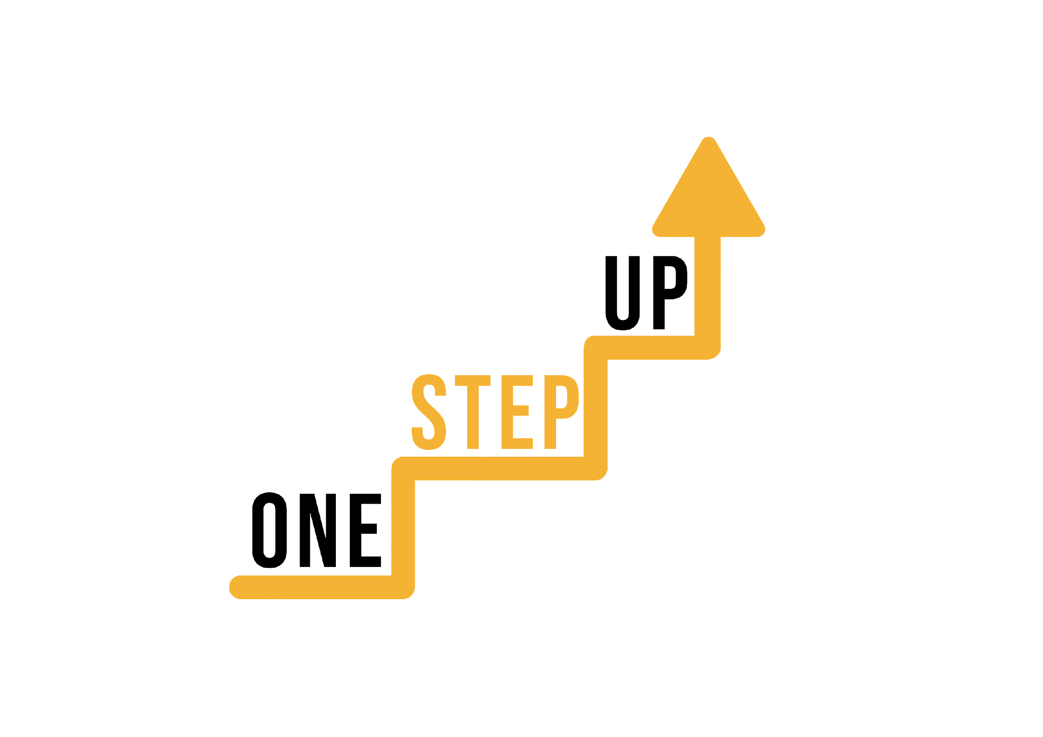
BREAK TIME!

Slide 33
Session 4
Gamification and Motivation
Notes:
Allocated time: 35 minutes

Slide 34
Recap of the previous session
The communication strategies discussed in the previous session;
The importance of communication and interaction in digital education.

Slide 35
Gamification Principles and Motivation (I)
Gamification involves integrating game-like elements into non-game contexts to enhance engagement and motivation. Here are the key principles of gamification and their impact on learner motivation:
Clear goals provide a sense of purpose and direction, motivating learners to work towards specific outcomes. Achieving goals triggers a sense of accomplishment;
Progression taps into learners' innate desire for growth and mastery. Advancing through levels creates a sense of achievement and encourages continued participation.
Immediate feedback informs learners about their performance, reinforcing positive behavior and guiding improvements. This fosters a sense of competence and helps maintain engagement.

Slide 36
Gamification Principles and Motivation (II)
Competition and Collaboration: Healthy competition sparks motivation by challenging learners to outperform themselves or others. Collaboration fosters a sense of community and shared achievement, enhancing motivation through social interaction;
Rewards provide intrinsic and extrinsic motivation. They acknowledge learners' efforts, leading to increased engagement and a desire to earn more rewards;
Social interaction promotes a sense of belonging and community. Learners engage more when they can share experiences, collaborate, and compete with peers;
Challenges and surprises evoke curiosity and excitement, preventing monotony and driving sustained engagement;

Slide 37
Gamification Principles and Motivation (III)
Personalization caters to individual preferences, fostering a sense of autonomy. Choice empowers learners and increases their investment in the learning process;
Immersive Storytelling: Stories create a relatable context and emotional connection. Immersive storytelling can lead to deeper engagement and a heightened sense of relevance;
Achievement and Leaderboards: Public recognition and visibility of achievements motivate learners to excel and compete. Leaderboards fuel a desire to be at the top and contribute to sustained engagement;
Playfulness makes learning enjoyable and reduces perceived difficulty. Fun interactions create positive emotions, contributing to enhanced motivation.

Slide 38
Small Group Activity: Designing a Gamified Learning Activity
Divide participants into small groups of 3-4 people.
01
02
03
04
05
Scenario Introduction
Gamification Elements
Design Considerations:
Rules and Mechanics
Presentation Structure:
Facilitator introduce a hypothetical learning scenario related to the workshop's topic.
For instance, designing a gamified activity for a remote language learning course.
Facilitator provides groups with distinct elements to incorporate into their gamified activity designs. Examples could include points, badges, levels, leaderboards, and rewards.
- Create tasks or challenges aligned with the learning scenario;
- Decide how participants can earn points or badges;
- Determine how levels or progression will be structured;
- Define rewards that motivate participation;
- Consider the desired duration and pacing of the activity.
Participants discuss and define the rules, mechanics, and guidelines for their gamified activity:
- How will participants earn points?
- How will progression work?
- What are the rules of engagement?
- Introduce the scenario and context;
- Explain the chosen gamification elements;
- Describe the rules and mechanics of the activity;
- Discuss how engagement and motivation will be fostered;
- Share the expected outcomes and benefits.

Slide 39
Short discussion & summarization.
QUESTIONS:
How did you align your activity design with the principles of goals, progression, feedback, and competition/collaboration?
What challenges did you face while designing the gamified activity, and how did you address them?
Q&A

Slide 40
Session 5
Assessment and Feedback
Notes:
Allocated time: 35 minutes

Slide 41
Recap of the previous session
Principles of gamification and their impact on learner motivation;
The role of gamification in enhancing engagement in digital environments.

Slide 42
Assessment Strategies and Effective Feedback
1. Formative and Summative Assessment:
Formative Assessment: Continuous, ongoing assessments that provide immediate insights into learner progress during the learning process.
Effective Feedback: Offer specific, constructive feedback that guides learners' understanding and highlights areas for improvement.
Summative Assessment: Assess learners' overall understanding and knowledge at the end of a unit or course.
Effective Feedback: Provide comprehensive feedback that reinforces their achievements and suggests ways to enhance their understanding for future learning.

Slide 43
Assessment Strategies and Effective Feedback
2. Authentic Assessments:
Description: Design assessments that mirror real-world tasks and scenarios, requiring learners to apply their knowledge and skills in practical contexts.
Effective Feedback: Relate feedback to real-world application, highlighting how their efforts align with practical skills and expectations.
3. Peer Assessment:
Description: Have learners assess and provide feedback on their peers' work, promoting critical thinking and self-evaluation.
Effective Feedback: Train learners to offer constructive feedback, emphasizing positive aspects and offering suggestions for improvement.

Slide 44
Assessment Strategies and Effective Feedback
4. Self-Assessment:
Description: Encourage learners to reflect on their own work and progress, promoting self-awareness and metacognitive skills.
Effective Feedback: Provide guidance on self-assessment, helping learners identify their strengths and areas for growth.
5. Interactive Quizzes and Polls:
Description: Incorporate quick quizzes and polls to gauge learners' understanding and engagement.
Effective Feedback: Offer immediate feedback after each question, explaining correct answers and addressing misconceptions.

Slide 45
Assessment Strategies and Effective Feedback
6. Scenario-Based Assessments:
Description: Present learners with real-world scenarios that require them to make decisions based on their understanding of the subject.
Effective Feedback: Provide feedback that discusses the consequences of their decisions and how they align with the subject matter.
7. Rubrics and Criteria:
Description: Clearly define assessment criteria and rubrics to communicate expectations and evaluation standards.
Effective Feedback: Align feedback with specific criteria, pointing out where learners excelled and where improvements can be made.

Slide 46
Assessment Strategies and Effective Feedback
8. Audio and Video Feedback:
Description: Provide feedback in the form of audio or video recordings, allowing for a more personalized and engaging approach.
Effective Feedback: Use tone, gestures, and expressions to convey encouragement and guidance effectively.
9. Timely Feedback:
Description: Offer feedback promptly after assessments to maintain learners' momentum and motivation.
Effective Feedback: Prioritize timely delivery while ensuring feedback is detailed and actionable.

Slide 47
Assessment Strategies and Effective Feedback
10. Goal-Oriented Feedback:
Description: Align feedback with learners' individual goals, emphasizing how their efforts contribute to their learning journey.
Effective Feedback: Acknowledge progress toward goals, suggesting strategies to further achieve them.

Slide 48
Role-play: Practicing Feedback Delivery in a Digital Setting ("Changing Role of an Educator")
Scenario: Imagine you are an educator providing feedback to a learner on a recent assignment submitted digitally. Your goal is to deliver feedback that is motivating, specific, and actionable, fostering engagement and supporting the learner's growth.
Roles:
Educator: The one providing feedback on the learner's assignment - Deliver feedback on the learner's assignment. Use effective strategies like using the learner's name, acknowledging strengths, and addressing areas for improvement;
Learner: The one receiving the feedback and responding to it - Respond to the feedback, asking questions for clarification or seeking further guidance.
Facilitator Observes: Observe the interaction and take note of the strategies used in the feedback delivery.

Slide 49
Discussion points
How did the feedback delivery strategies used by the educator impact the learner's engagement and motivation?
What specific techniques were employed to make the feedback motivating, specific, and actionable?
How does this role-play highlight the evolving role of educators in the digital age?

Slide 50
Key Strategies for Effective Feedback Delivery:
Personalization;
Constructive Criticism;
Engagement;
Positive Reinforcement;
Clarity and Simplicity;
Future-Focused.
Specificity;
Encouragement;

Slide 51
Session 6
Adapting Engagement Strategies
Notes:
Allocated time: 35 minutes

Slide 52
Recap of the previous session
The importance of using assessment and feedback to drive engagement;
Feedback importance in enhancing learner motivation.

Slide 53
Personalization Strategies and Adaptation
Personalizing engagement strategies is essential to cater to the diverse needs, preferences, and learning styles of your learners. Here are some effective strategies and techniques for adapting engagement approaches:

Slide 54
Personalization Strategies and Adaptation
1. Learning Styles:
Strategy: Identify different learning styles (visual, auditory, kinesthetic) and tailor engagement activities to match.
Techniques: Provide visual materials, incorporate audio elements, and include hands-on activities to accommodate various learning preferences.

Slide 55
Personalization Strategies and Adaptation
2. Flexible Pathways:
Techniques: Provide a variety of topic options or allow learners to select projects aligned with their passions.
Strategy: Offer learners the flexibility to choose their learning paths based on their interests and strengths.

Slide 56
Personalization Strategies and Adaptation
3. Choice and Autonomy:
Strategy: Empower learners by offering choices in assignments and activities, promoting a sense of ownership.
Techniques: Allow learners to select from multiple project topics or let them decide how to demonstrate their understanding.

Slide 57
Personalization Strategies and Adaptation
4. Cultural Sensitivity:
Strategy: Respect learners' cultural backgrounds by integrating diverse perspectives and references.
Techniques: Incorporate examples, case studies, and content from various cultures to enhance relevance and inclusivity.

Slide 58
Personalization Strategies and Adaptation
5. Personal Learning Goals:
Strategy: Encourage learners to set their own learning goals, making the learning experience more meaningful.
Techniques: Have learners define what they want to achieve and how they intend to achieve it, aligning goals with your course objectives.

Slide 59
Personalization Strategies and Adaptation
6. Adaptive Content:
Strategy: Use adaptive learning platforms that adjust content based on learners' performance and progress.
Techniques: Utilize platforms that analyze learner responses and tailor subsequent content to address areas of challenge.

Slide 60
Personalization Strategies and Adaptation
7. Scaffolding:
Strategy: Provide structured support that gradually decreases as learners become more confident.
Techniques: Start with simpler tasks and gradually increase complexity, allowing learners to build skills incrementally.

Slide 61
Personalization Strategies and Adaptation
8. Varied Assessments:
Techniques: Combine quizzes, essays, presentations, and projects to allow learners to demonstrate their understanding in various ways.
Strategy: Offer diverse assessment methods that cater to different learning strengths.

Slide 62
Personalization Strategies and Adaptation
Techniques: Highlight their accomplishments, address challenges, and suggest strategies for improvement.
Strategy: Deliver individualized feedback that addresses learners' specific strengths and areas for growth.
9. Personalized Feedback:

Slide 63
Personalization Strategies and Adaptation
10. Learner-Centric Activities:
Strategy: Design activities based on learners' interests, sparking motivation and engagement.
Techniques: Incorporate topics and scenarios that resonate with learners' passions and real-world contexts.

Slide 64
Personalization Strategies and Adaptation
11. Real-World Relevance:
Strategy: Show learners how the content is applicable in real-life situations.
Techniques: Share case studies, examples, and success stories that demonstrate the practical value of the concepts being taught.

Slide 65
Collaborative Activity: Sharing and Refining Individualized Engagement Plans (I)
The purpose of the activity - to collectively enhance engagement plans through peer insights and collaboration.
Divide participants into small groups (3-4 people). Ensure diversity in terms of teaching contexts, subjects, and experiences;
Assign each group a specific topic or theme for which they will share and refine engagement plans;
Within their small groups, participants take turns sharing their individualized engagement plans for the assigned topic. They can provide an overview of their strategies and methods. (Note: Each participant should have about 2 minutes to present their plan.)

Slide 66
Collaborative Activity: Sharing and Refining Individualized Engagement Plans (II)
4. After each participant presents their plan, the group engages in a discussion. Other group members offer constructive feedback, suggestions, and insights to enhance the engagement strategies presented.
Guiding Questions:
What elements of the engagement plan resonate with your teaching context?
How can specific personalization techniques be integrated to better address diverse learner needs?
Are there any innovative approaches that could be applied to enhance engagement?
What challenges might arise when implementing these strategies, and how could they be mitigated?

Slide 67
Collaborative Activity: Sharing and Refining Individualized Engagement Plans (III)
5. After receiving feedback, participants take a few minutes to revise and refine their engagement plans based on the insights gained from the group discussion. (Note: Emphasize that participants can adapt feedback to suit their teaching style and learners' characteristics.)
6. Participants reconvene as a whole group. Each small group selects one engagement plan that has been refined based on the feedback received. One representative from each group briefly shares the revised plan with the entire audience.
Reflection: After each presentation, encourage reflections on the collaborative process and the value of peer feedback.

Slide 68
FAQ
Do you have any questions related to the content of the workshop? Feel free to ask them now!
Notes:
Allocated time: 10 minutes

Slide 69
Evaluation & Conclusion
What have you learned today? How will you be able to use your new knowledge and skills in the future?
Please, fill out the evaluation survey!
Notes:
Allocated time: 10 minutes

Slide 70
THANK YOU!

Slide 71
Funded by the European Union. Views and opinions expressed are however those of the author(s) only and do not necessarily reflect those of the European Union or the National Agency. Neither the European Union nor National Agency can be held responsible for them. Project Number: 2022-1-LT01-KA220-ADU-000085898

