Slide 1
Professional Development Training for Front-line Adult Educators
Module 3: Introduction to Engagement Strategies in Digital Environments
Self-directed learning resources

Slide 2
MODULE 3
This module includes 14 hours of learning content.
6 hours of F2F learning
8 hours of self-directed learning
This presentation covers the 6 hours of F2F learning.
It is accompanied by a Lesson Plan for the facilitator.
Go through the presentation with self-directed learning resources at your own pace!
Notes:
1 academic hour = 45 minutes

Slide 3
Introduction
This presentation includes self-directed learning resources and a self-reflection exercise.
Feel free to select the resources that best align with your interests and learning goals.
These resources can be explored independently, without any prescribed order or requirement to go through all of them.

Slide 4
Introduction to Engagement Strategies in Digital Environments (I)
Resource 1: Video Presentation (1h 14min)
Watch a video presentation about Creating a Culture of Engagement in the Adult Classroom;
Gain insights into the importance of engagement and its impact on learning outcomes.
Link: https://www.youtube.com/watch?v=25H09leLyf4
Use automatic Youtube translations.

Slide 5
Introduction to Engagement Strategies in Digital Environments (II)
Self-Reflection Exercise (15 minutes)
Take notes on key concepts from the presentation.
Reflect on your own teaching experiences and how engagement strategies have influenced your learners.

Slide 6
2. Working in Non-Traditional Environments (I)
Resource 2: Article Reading (1 hour)
Read an article about the challenges and benefits of working in non-traditional teaching environments.
Gain an understanding of how digital environments have transformed education.
Link: https://onlinelibrary.wiley.com/doi/epdf/10.1111/ijtd.12171
For the translation of the article - try deeple.com
SUMMARY of the article
“The relationship between trainers’ media-didactical competence and media-didactical self-efficacy, attitudes and use of digital media in training”
Caroline Bonnes, Carmen Leiser,Bernhard Schmidt-Hertha, Karin Julia Rott and Sabine Hochholdinger
The ongoing digitalization in the training sector produces new demands on the media-didactical competence of trainers. We conducted an online survey of 279 trainers in Germany to investigate the relationships among media-didactical competence, media-didactical self-efficacy, attitudes toward the use of digital media and the actual use of digital media in training. Furthermore, we compared trainers who attended a course on digital media with trainers who did not attend such a course. The analysis of the theoretically expected correlations between the variables resulted in not all hypotheses being accepted. The analysis of the group differences showed that the trainers who attended a course on digital media had higher media-didactical competence and media-didactical self-efficacy scores and used digital media more often in training. There was no significant difference in negative attitudes. The implications for the promotion of the media-didactical competence of trainers are discussed.

Slide 7
2. Working in Non-Traditional Environments (II)
Self-Reflection Exercise (30 minutes)
Reflect on how the insights from the article apply to your teaching context.
Identify potential opportunities and challenges when engaging learners in non-traditional settings.

Slide 8
3. Strategies for Engaging Hard-to-Reach Adult Learners through Social Media Platforms (I)
“The adoption of social media by adult learners as an e-learning platform”
Moodley, P
ABSTRACT: Recent technological developments have increased the platforms and capacity for learning at HEIs. Whilst the adoption of web 2.0 tools by undergraduates continues to be a focus in e-learning discourse, attention should be given to adult learners who are forced to adapt to the spate of technologically innovative educational practices. This paper, explores the experience of adult learners use of social media which is used as an e-learning platform for a course in Research Methodology (RMBA 201). A Facebook page was set up and monitored for the duration of the course which was regularly updated with course slides (in the form of videos) and notifications. Non-probability sampling technique was used in the selection of the sample. Only adult learners’ who accessed the prescribed social media designed for the course were eligible to participate in this study. This meant that purposive sampling was used to generate the desired sample. Fifty seven adult learners completed a closed ended questionnaire. The study reveals that although the adult learners were slow to grasp the concept of social media as an e-learning platform, their interest grew exponentially week on week. Furthermore, the test periods saw immense activity from adult learners on the social media, which was indicative of the social media’s usefulness as an e-learning platform.
Resource 3: Webinar Recording (1 hour)
Read an article on how adult learners adapt to social media as an e-learning platform: https://www.researchgate.net/publication/335364325_THE_ADOPTION_OF_SOCIAL_MEDIA_BY_ADULT_LEARNERS_AS_AN_E-LEARNING_PLATFORM
For the translation of the article - try deeple.com
Learn practical tips and case studies from educators who have successfully utilized social media for engagement - https://epale.ec.europa.eu/en/blog/social-media-adult-learning-benefits-and-uses (use translation possibility on the page).

Slide 9
3. Strategies for Engaging Hard-to-Reach Adult Learners through Social Media Platforms (II)
Self-Reflection Exercise (30 minutes)
Jot down key takeaways from the article and the blog.
Brainstorm ways you could adapt social media strategies to connect with your own learners.

Slide 10
4. The Changing Role of Educators in Digital Environments (I)
Resource 4: Online Discussion Forum (1 hour)
Participate in an online discussion forum where educators share their experiences and insights on the evolving role of educators in digital environments.
Engage in conversations and learn from peers' perspectives.
Link: https://transformingeducationsummit.sdg4education2030.org/AT4DiscussionForum

Slide 11
4. The Changing Role of Educators in Digital Environments (II)
Self-Reflection Exercise (30 minutes)
Summarize key points from the forum discussions.
Reflect on how you can incorporate the changing role of educators into your own teaching practices.

Slide 12
5. Strategies for Digital Interaction and Community Building (I)
Resource 5: articles and blogs (1 hour)
Read an article that delves into strategies for fostering digital interaction and building a sense of community in online learning environments.
https://files.eric.ed.gov/fulltext/EJ1210946.pdf
For the translation of the article - try deeple.com
“Teaching to Connect: Community-Building Strategies for the Virtual Classroom” Sharla Berry, California Lutheran University
ABSTRACT: A sense of community is central to student engagement and satisfaction. However, many students struggle with developing connections in online programs. Drawing on interviews with 13 instructors, this paper explores the strategies that they use to help students develop a sense of community in synchronous virtual classrooms. Four strategies for building community online are identified: reaching out to students often, limiting time spent lecturing, using video and chat as modes to engage students, and allowing class time to be used for personal and professional updates.

Slide 13
5. Strategies for Digital Interaction and Community Building (II)
Explore techniques such as:
Gain some practical tips and ideas:
https://kpcrossacademy.org/building-community-in-online-courses/ ;
https://ecampusontario.pressbooks.pub/aguideforbusyeducators/chapter/cultivating-community-building-in-online-learning-environments/
https://www.learnworlds.com/build-online-learning-community/
Discussion forums
Virtual meetups
Collaborative projects

Slide 14
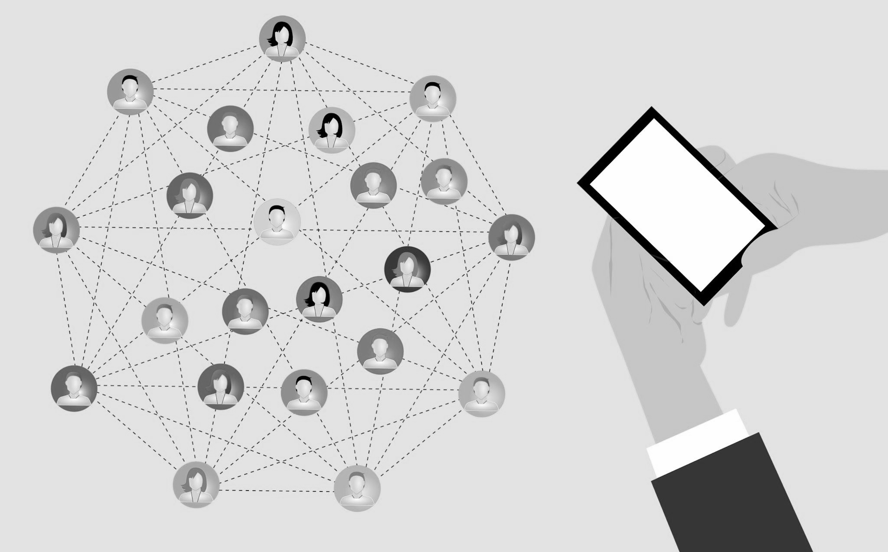
5. Strategies for Digital Interaction and Community Building (III)
Self-Reflection Exercise (30 minutes)
Take notes on key strategies mentioned in the e-book and the blog.
Reflect on how you can apply these strategies to cultivate engagement and community in your digital teaching environment.

Slide 15
6. Final Reflection (30 minutes)
Reflect on the entire learning journey:
What were the most significant insights you gained from each section?
How will you apply the engagement strategies, especially in non-traditional environments?
What steps will you take to engage hard-to-reach learners through social media platforms?
How has your perception of the changing role of educators evolved?
How can you leverage the strategies for digital interaction and community building you've learned to create a dynamic and inclusive online learning environment that fosters active engagement and meaningful connections among your learners?"

Slide 16
Conclusion
Thank you for going through these self-directed learning activities.
If you enjoyed this module, we recommend you to explore other ONE STEP UP resources.

Slide 17
THANK YOU!

Slide 18
“The European Commission’s support of this publication does not constitute an endorsement of the contents, which reflect the views only of the authors, and the Commission can not be held responsible for any use which may be made of the information therein.”
Project Number: 2022-1-LT01-KA220-ADU-000085898

