Slide 1
Professional Development Training for Front-line Adult Educators
Module 2: Developing Micro-Learning Resources for Low-Skilled Adults

Slide 2
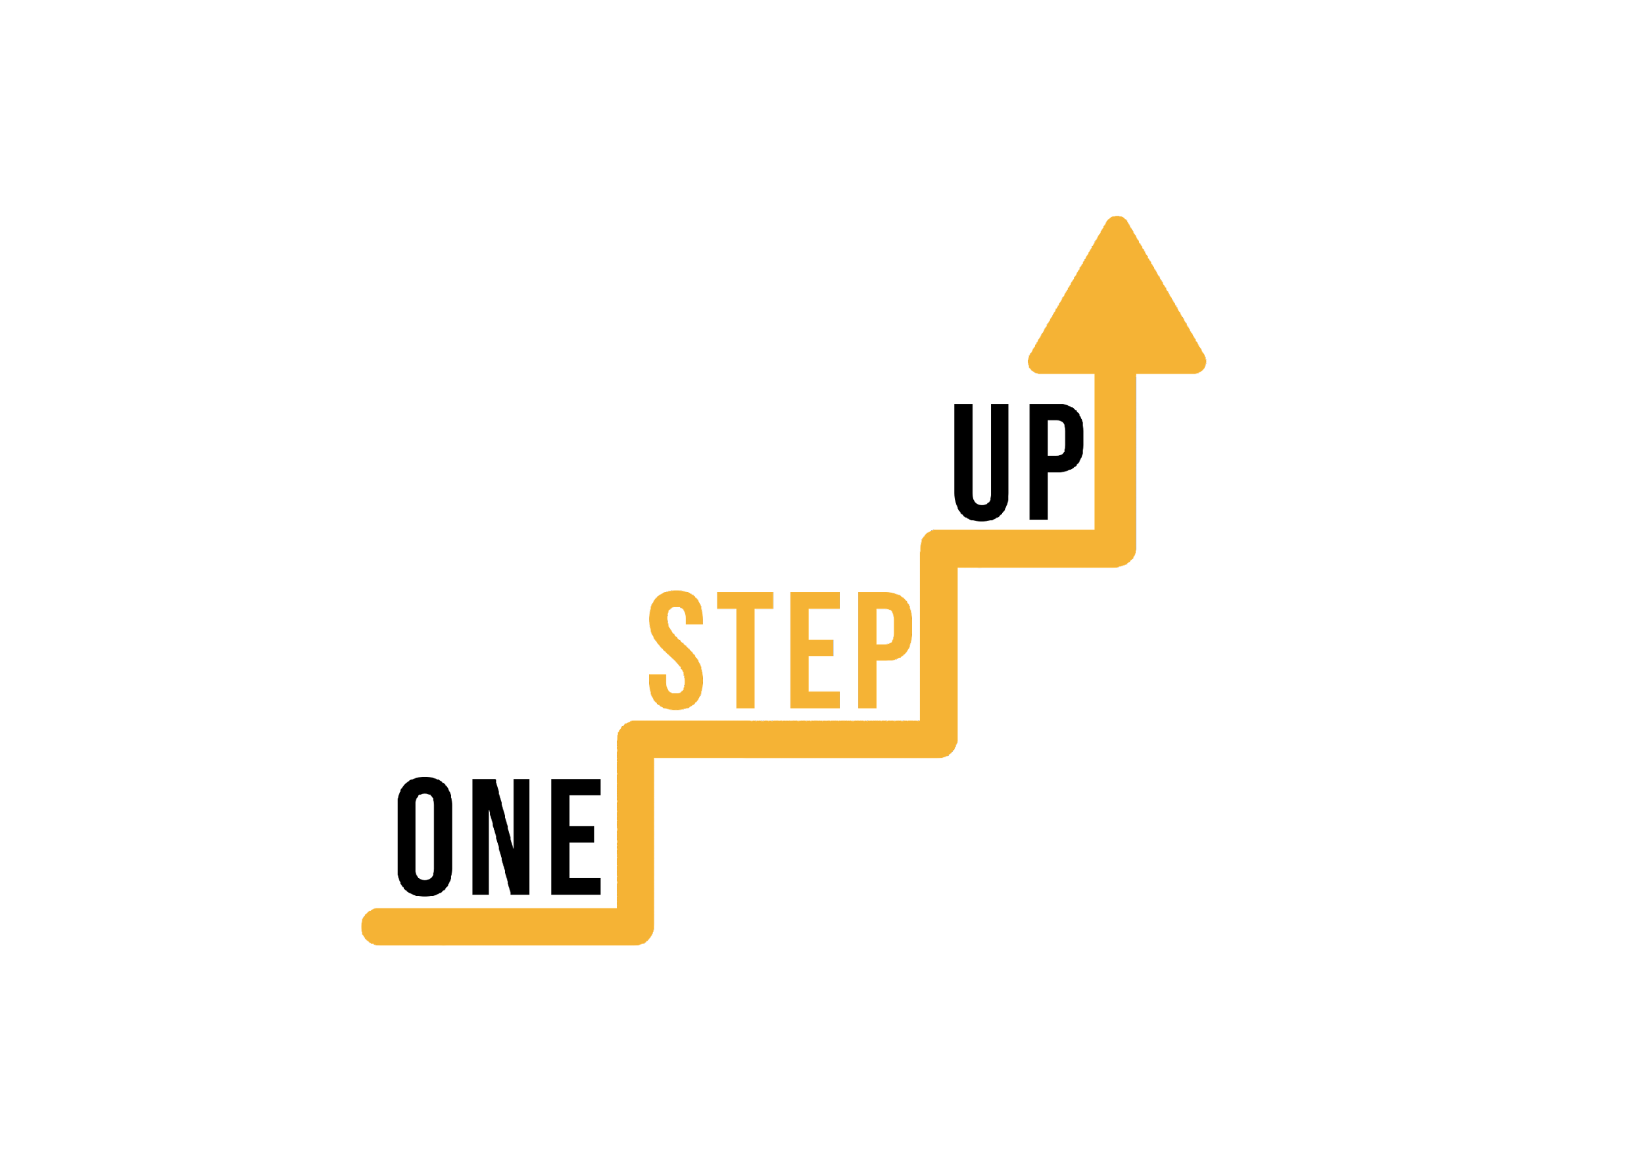
MODULE 2
This module includes 14 hours of learning content.
6 hours of F2F learning
8 hours of self-directed learning
This presentation covers the 6 hours of F2F learning.
It is accompanied by a Lesson Plan for the facilitator.
Go through the presentation with self-directed learning resources at your own pace!
Notes:
1 academic hour = 45 minutes

Slide 3
Part 1 – Introduction and Icebreaker
Part 2 – Overview of micro-learning and its benefits
Part 3 – Digital tools and platforms for creating micro-learning resources
TABLE OF CONTENT
Part 4 - Addressing common challenges and barriers to micro-learning adoption

Slide 4
Part 1
Introduction & icebreaker
Notes:
Allocated time: 30 minutes

Slide 5
In this presentation, we'll explore how adult educators can develop their own digital micro-learning resources to support low-skilled adults.
By the end of this presentation, you'll have a better understanding of the tools and strategies needed to create effective micro-learning resources.
Hello!

Slide 6
Did you know that in many European countries, the majority of low-skilled adults are not receiving the education and training they need to succeed in today's workforce?
Micro-learning resources could be the key to reaching these individuals.

Slide 7
Activity 1: Icebreaker – Digital Scavenger Hunt
Divide the participants into teams of 3-4 people.
Give each team a list of digital tools, platforms, or apps that can be used to create micro-learning resources. For example, you could include tools like Canva, Quizlet, or Kahoot.
Ask the teams to use their smartphones or laptops to search for information about each tool on the list. They should try to find out what the tool is used for, how it works, and any advantages or disadvantages.
Once they have found the information, they should share it with the rest of their team and decide which tool they think would be most useful for creating micro-learning resources.
Finally, ask each team to present their chosen tool and explain why they think it would be effective for creating digital micro-learning resources.
Notes:
Allocated time: 30 minutes
This icebreaker will not only help participants to get familiar with digital tools that they can use for creating micro-learning resources, but also to encourage team building and communication skills.
Use this list of digital tools, platforms, or apps. Each team should receive at least 3 items.
Articulate 360
Adobe Captivate
Camtasia
H5P
iSpring Suite
Canva
Kahoot
Quizlet
Genially
Mentimeter
Elucidat
Easygenerator
Lectora Inspire
EdApp
Docebo Content Creator
WizIQ
Powtoon
Vyond
Prezi
Animaker

Slide 8
Part 2
Overview of micro-learning and its benefits
Notes:
Allocated time: 25 minutes

Slide 9
What is micro-learning?
Micro-learning is an approach to learning that delivers information in small, bite-sized chunks.
These chunks are typically no more than a few minutes long and can be delivered through a variety of digital channels.
Micro-learning can be used to supplement or reinforce traditional forms of learning, or as a standalone approach for learners who prefer shorter, more focused learning sessions.
Micro-learning can be used to provide just-in-time information, allowing learners to quickly and easily access information when they need it most.

Slide 10
The benefits
Flexible and accessible: Learners can access micro-learning resources anytime, anywhere, and on any device.
Personalized: Micro-learning can be tailored to the specific needs and interests of individual learners.
Engaging: The short, interactive nature of micro-learning can make it more engaging and enjoyable than traditional forms of learning.

Slide 11
The effectiveness
Research has shown that micro-learning can be an effective way to deliver information and improve learning outcomes.
Studies have found that learners retain more information when it is presented in small, focused chunks.
Micro-learning can also help improve learner motivation and engagement, leading to better learning outcomes.

Slide 12
Applications
Micro-learning can be applied to a variety of learning goals, such as job training, skill development, and personal enrichment.
It can also be used in a variety of settings, including schools, businesses, and non-profits.
Micro-learning can be particularly effective for low-skilled adults who may have limited time or resources for traditional forms of learning

Slide 13
Best practices
To design effective micro-learning resources, consider the needs and interests of your target audience.
Use visuals, interactive elements, and other engaging techniques to capture learners' attention,
Keep content focused and concise, with clear learning objectives and outcomes in mind.

Slide 14
Part 3
Digital tools and platforms for creating micro-learning resources
Notes:
Allocated time: 150 minutes

Slide 15
Digital tools
Digital tools and platforms play a crucial role in creating effective micro-learning resources. They offer a wide range of features and functionalities to enhance the learning experience.
These tools enable educators to design interactive and engaging content, incorporating multimedia elements such as videos, images, and quizzes. With customization options, educators can tailor the resources to meet specific learning goals and address the needs of their audience.

Slide 16
Digital tools
Collaboration is facilitated through these tools and platforms, allowing educators to work together in creating micro-learning resources. By leveraging the capabilities of digital tools and platforms, educators can make micro-learning accessible and adaptable for diverse audiences. This promotes inclusivity and supports personalized learning experiences.
When selecting tools and platforms, it is important to align them with the learning goals and requirements of the audience, ensuring that the chosen tools effectively contribute to the creation of impactful micro-learning resources.

Slide 17
Activity 2: Discussion
Divide participants into small groups of 4-6 people.
Provide each group with a list of digital tools and platforms commonly used for creating micro-learning resources. Use the same list provided earlier or customize it based on your preferences.
Instruct the groups to discuss the following points for a tool or platform they choose:
How user-friendly is the tool/platform? Are there any technical or design skills required?
What specific features and functionalities does the tool/platform offer? How do they support micro-learning resource creation?
Can the tool/platform be customized to meet specific needs and preferences?
How does the tool/platform facilitate interactivity and learner engagement?
Does the tool/platform enable collaboration among educators or learners?
Is the tool/platform affordable? Is it easily accessible, particularly for low-skilled adults?
Share any examples or success stories of how the tool/platform has been used effectively for micro-learning.
Notes:
Use this list of digital tools, platforms, or apps. Some of them are introduced with a video. You can find them on slides 20 to 28.
Articulate 360
Adobe Captivate
Camtasia
H5P
iSpring Suite
Canva
Kahoot
Quizlet
Genially
Mentimeter
Elucidat
Easygenerator
Lectora Inspire
EdApp
Docebo Content Creator
WizIQ
Powtoon
Vyond
Prezi
Animaker

Slide 18
Activity 2: Discussion
4. Encourage participants to share their own experiences, insights, and opinions about the tools/platforms. They can discuss the pros and cons, challenges they have faced, and any tips or best practices they have discovered.
5. As a facilitator, move between the groups, actively listen to the discussions, and ask guiding questions to stimulate deeper conversation and reflection.
6. After a designated discussion period, bring the groups back together as a whole and initiate a larger group discussion.
7. In the larger group discussion, ask each group to share their key findings and insights. Encourage participants from other groups to add their thoughts, provide additional perspectives, or ask questions.
8. Summarize the main points raised during the discussion and highlight any patterns or common themes that emerge.
9. Conclude the activity by facilitating a brief reflection session, where participants can share their key takeaways from the discussion.
Notes:
By focusing on group discussion rather than individual research or outcome creation, this activity will allow participants to tap into their collective knowledge, learn from each other's experiences, and engage in meaningful conversations about the digital tools and platforms relevant to micro-learning resource development.

Slide 19
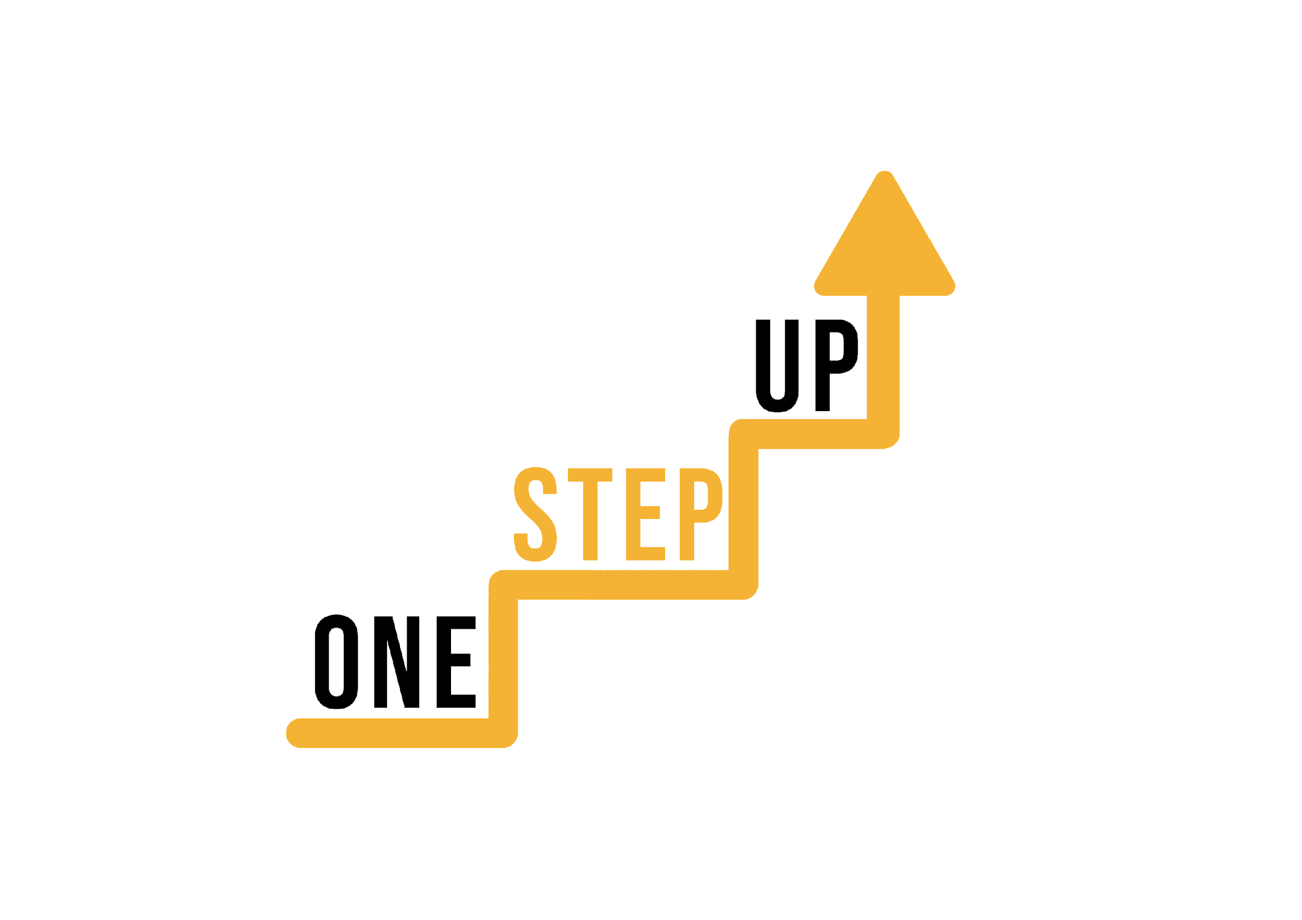
BREAK TIME!

Slide 20
Videos
On the following slides, eight platforms and tools are introduced.

Slide 21
Video: Kahoot

Slide 22
Video: Mentimeter

Slide 23
Video: Articulate 360

Slide 24
Video: Canva

Slide 25
Video: Powtoon

Slide 26
Video: H5P

Slide 27
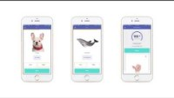
Video: Quizlet

Slide 28
Video: Genially

Slide 29
Activity 3: Creating a micro-learning resource
Divide participants into small groups of 3-5 people.
Provide each group with a specific topic or subject area related to low-skilled adults that they will focus on for their micro-learning resource. Examples could include basic financial literacy, digital skills, health and wellness, or workplace communication.
Explain that the goal of the activity is for each group to collaboratively design and create a micro-learning resource on their assigned topic using a digital tool or platform of their choice.
Allocate time for the following steps that are explained on the next slide.
Notes:
This activity is the main one of this workshop. Its objective is to provide participants with a hands-on experience in creating a micro-learning resource using digital tools and platforms, fostering their creativity and understanding of the micro-learning design process.

Slide 30
CREATION
Instruct the groups to use their chosen digital tool or platform to create the micro-learning resource. They can develop slides, interactive modules, videos, quizzes, or any other format that suits their content and tool/platform capabilities.
Encourage them to utilize multimedia elements such as images, videos, and audio to enhance the learning experience.
Remind participants to ensure the resource is visually appealing, accessible, and aligned with the learning objectives identified in the planning phase.
PLANNING
Encourage the groups to brainstorm and outline the key concepts, learning objectives, and structure of their micro-learning resource.
Advise them to consider the target audience, learning outcomes, and any specific challenges or needs of low-skilled adults.
Remind them to keep the resource concise, engaging, and focused on delivering bite-sized learning.
REVIEW
Advise the groups to review their micro-learning resource and make necessary revisions or improvements.
Encourage them to check for clarity, accuracy, and consistency in the content, as well as test any interactive elements or activities.

Slide 31
Activity 3: Creating a micro-learning resource
5. After the designated time, ask each group to present their micro-learning resource to the rest of the participants. Allocate 5-7 minutes for each group's presentation, including a brief explanation of the topic, an overview of the resource, and a demonstration of its key features.
6. As participants present, encourage others to provide feedback and ask questions. Foster a supportive and constructive environment for sharing ideas and suggestions.
7. Allow time for a brief discussion following each presentation, where participants can reflect on the strengths and areas for improvement in each micro-learning resource.
Notes:
This activity should take about 70 minutes, depending on the number of groups.
It offers a practical and collaborative experience for participants. By engaging in the process of designing and developing a micro-learning resource, participants can directly apply the concepts and principles discussed in the workshop to a real-world scenario.
Through this hands-on activity, participants have the chance to actively explore different digital tools and platforms for creating micro-learning resources. They can experiment with multimedia elements, interactive features, and various formats to enhance the learning experience.
By working in small groups, participants can benefit from the diverse perspectives and expertise of their peers. Collaboration fosters creativity and encourages participants to discuss and exchange ideas, leading to a richer learning experience. The activity also promotes teamwork and communication skills as groups work together to plan, create, and refine their micro-learning resource.

Slide 32
Part 4
Addressing common challenges and barriers to micro-learning adoption
Notes:
Allocated time: 35 minutes

Slide 33
Common challenges to micro-learning adoption
Lack of awareness
Many organizations are not aware of the benefits and potential of micro-learning.
Resistance to change
Some stakeholders may resist adopting micro-learning due to traditional training methods.
Technical constraints
Limited access to technology or poor digital infrastructure can hinder micro-learning implementation.
Content development
Creating bite-sized and engaging content can be time-consuming and challenging.

Slide 34
Overcoming challenges
Increasing awareness
Conduct awareness campaigns and training sessions to educate stakeholders about the advantages of micro-learning.
Change management
Implement change management strategies to address resistance and promote a culture of continuous learning.
Technology solutions
Invest in suitable technology infrastructure and provide necessary resources for effective micro-learning implementation.
Content development support
Establish guidelines and provide tools to support trainers and subject matter experts in developing engaging micro-learning content.

Slide 35
Adressing barriers
Personalized learning paths
Tailor micro-learning content to individual learners' needs and preferences.
Gamification and rewards
Incorporate game elements and incentives to enhance learner engagement and motivation.
Mobile-friendly approach
Ensure that micro-learning content is accessible on mobile devices to accommodate flexible learning.
Social learning opportunities
Encourage collaboration and knowledge-sharing through discussion forums, chat groups, or virtual classrooms.

Slide 36
Evaluating your micro-learning resources
01
02
03
04
Set clear goals
Track learner progress
Collect feedback
Continuous improvement
Define specific learning objectives and performance outcomes that can be achieved through micro-learning.
Regularly gather feedback from learners and trainers to identify areas for improvement and make necessary adjustments.
Implement a robust tracking and analytics system to monitor learner engagement, completion rates, and knowledge retention.
Use data and insights to iterate and enhance micro-learning programs, ensuring they remain effective and relevant.

Slide 37
Success stories and examples
Showcase success stories
Highlight examples of organizations that have successfully adopted micro-learning and achieved positive outcomes.
Demonstrate impact
Share data and metrics showcasing the benefits of micro-learning, such as increased knowledge retention, improved performance, and reduced training costs.
Provide testimonials
Include quotes or testimonials from learners or trainers who have experienced the value of micro-learning firsthand.
Inspire others
Use these examples to motivate and encourage other organizations to overcome their challenges and embrace micro-learning.

Slide 38
FAQ Session
Do you have any questions related to the content of the workshop? Feel free to ask them now!
Notes:
Allocated time: 10 minutes

Slide 39
Evaluation & Conclusion
What have you learned today? How will you be able to use your new knowledge and skills in the future?
Please, fill out the online evaluation survey!
Notes:
Allocated time: 10 minutes

Slide 40
THANK YOU!

Slide 41
“The European Commission’s support of this publication does not constitute an endorsement of the contents, which reflect the views only of the authors, and the Commission can not be held responsible for any use which may be made of the information therein.”
Project Number: 2022-1-LT01-KA220-ADU-000085898

