Slide 1
Professional Development Training for Front-line Adult Educators
Module 2: Educators Developing Micro-Learning Resources for Low-Skilled Adults
Self-directed learning resources

Slide 2
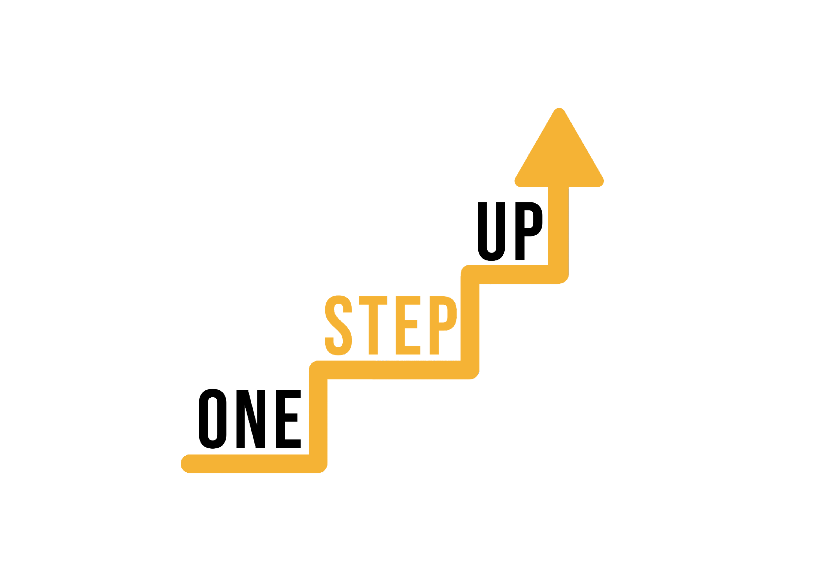
MODULE 2
This module includes 14 hours of learning content.
6 hours of F2F learning
8 hours of self-directed learning
This presentation covers the 6 hours of F2F learning.
It is accompanied by a Lesson Plan for the facilitator.
Go through the presentation with self-directed learning resources at your own pace!
Notes:
1 academic hour = 45 minutes

Slide 3
Introduction
This presentation includes nine self-directed learning resources and a self-reflection exercise.
Feel free to select the resources that best align with your interests and learning goals.
These resources can be explored independently, without any prescribed order or requirement to go through all of them.
Notes:
Allocated time: 10 minutes

Slide 4
SDLR 1: What is Microlearning?
Notes:
In certain instances, relying solely on a 12-hour online course might not be the most effective approach to fostering student engagement. This is where the concept of "Microlearning" comes into play. Microlearning entails acquiring knowledge through small, easily manageable portions of content that are delivered to learners precisely when and where they require it. The underlying principle involves breaking down the subject matter into concise, readily digestible elements that address specific learning objectives.

Slide 5
SDLR 2: Kahoot Tutorial
Notes:
The tutorial video titled provides a step-by-step guide on utilizing Kahoot as a quiz creation tool. Russell explains important settings and features, including setting up a free Kahoot account, creating quizzes, previewing and sharing them, and testing quizzes. The video also covers logging in as a student, checking reports, and providing feedback. Russell emphasizes the use of the free version of Kahoot, showcasing its functionality in various educational settings. Additionally, the tutorial explores Kahoot's latest updates and discusses the limitations of the free version, suggesting paid options or alternative tools as alternatives.

Slide 6
SDLR 3: Mentimeter Tutorial
Notes:
This video serves as a complete introduction to Mentimeter, covering its key components and functionalities. It focuses on the various uses of the free tool and demonstrates how it can engage students in both online and classroom settings. With Mentimeter, you can create unlimited presentations, each containing up to three questions. The tool offers a wide range of question types, such as multiple choice and word clouds, enabling you to collect opinions and conduct voting among students. Mentimeter proves effective for online teaching, allowing quick creation and sharing of questions to assess student understanding. Furthermore, it can enhance in-person presentations by enabling real-time audience interaction through their mobile devices. Mentimeter's simplicity, customizable appearance, and ability to provide immediate feedback make it an ideal tool for engaging students and creating interactive lessons.

Slide 7
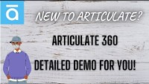
SDLR 4: Articulate 360 Tutorial
Notes:
In this video, you'll find a comprehensive overview of Articulate 360, a leading course development tool and course authoring tool. Articulate 360 comprises a collection of eight applications, including Storyline 360 and Rise 360. This free tutorial series covers everything from beginners to experts, providing a one-stop resource for learning Articulate Storyline and getting started with your first course creation.

Slide 8
SDLR 5: Canva Tutorial
Notes:
This video provides a complete Canva tutorial for beginners, explaining all the functionalities, effects, and techniques you can employ to create engaging graphics. Canva is a free publishing and graphics design tool that allows you to ideate, create, and publish graphics and images for social media, websites, blogs, presentations, posters, flyers, and more.

Slide 9
SDLR 6: Powtoon Tutorial
Notes:
Powtoon is renowned for its user-friendliness and ease of use, making it accessible to both novices and experienced users. By following this super helpful tutorial, you'll quickly grasp the fundamentals and unlock the full potential of Powtoon, enabling you to create engaging and visually appealing animated videos that captivate your audience.

Slide 10
SDLR 7: H5P Tutorial
Notes:
With H5P, content creators and educators can easily develop and integrate interactive elements into their websites, e-learning courses, and online platforms. It eliminates the need for complex coding or programming skills, as H5P offers a simple, intuitive interface for creating interactive content. Users can customize the appearance, behavior, and interactivity of each content type to meet their specific needs.

Slide 11
SDLR 8: Quizlet Tutorial
Notes:
Quizlet is a powerful tool that offers a compact and user-friendly platform for practicing and mastering the material you need to learn. Whether you're a student looking to reinforce your understanding or a teacher seeking innovative ways to engage your students, Quizlet has got you covered.
With Quizlet, you can create personalized study sets that include flashcards, quizzes, and interactive games, tailored to your specific learning objectives. These study sets can be shared with others, allowing for collaborative learning and knowledge exchange. Additionally, Quizlet provides access to a vast library of user-generated study sets, covering a wide range of subjects and topics.

Slide 12
SDLR 9: Genially Tutorial
Notes:
Genially is an innovative online tool that allows you to create captivating and interactive content in various formats, such as presentations, infographics, interactive videos, resumes, flow charts, and interactive images. With its wide range of features and functionalities, Genially empowers users to design visually stunning and engaging materials that captivate their audience.

Slide 13
Self-reflection questions
What motivated you to explore micro-learning and its applications in your work with students? Were there any specific challenges or needs that drove your interest?
As you learned about micro-learning, what key insights or concepts resonated with you the most? How do you envision implementing these ideas in your teaching practice?
Reflect on the process of creating a micro-learning resource. What did you find most challenging or rewarding about this experience? How did it enhance your understanding of the principles behind effective micro-learning design?
Notes:
Congratulations on completing your self-directed learning activities on micro-learning! Self-reflection is a crucial step in the learning process.

Slide 14
Reflect on your own learning preferences and styles. How did this self-directed learning experience align with your preferred learning methods? Did it present any new challenges or opportunities for growth?
Consider the potential impact of micro-learning on your students' learning experience. How do you think incorporating micro-learning into your teaching practice could benefit them? Are there any specific learning outcomes you hope to achieve?
Reflect on any obstacles or barriers you foresee in implementing micro-learning strategies with your students. How do you plan to address these challenges and ensure a smooth integration of micro-learning into your teaching?
Finally, based on your research and learning experiences, what key advice or recommendations would you give to other educators interested in incorporating micro-learning into their teaching practice? What important factors should they consider?
Notes:
Congratulations on completing your self-directed learning activities on micro-learning! Self-reflection is a crucial step in the learning process.

Slide 15
Conclusion
Thank you for going through these self-directed learning activities.
If you enjoyed this module, we recommend you to explore other ONE STEP UP resources.

Slide 16
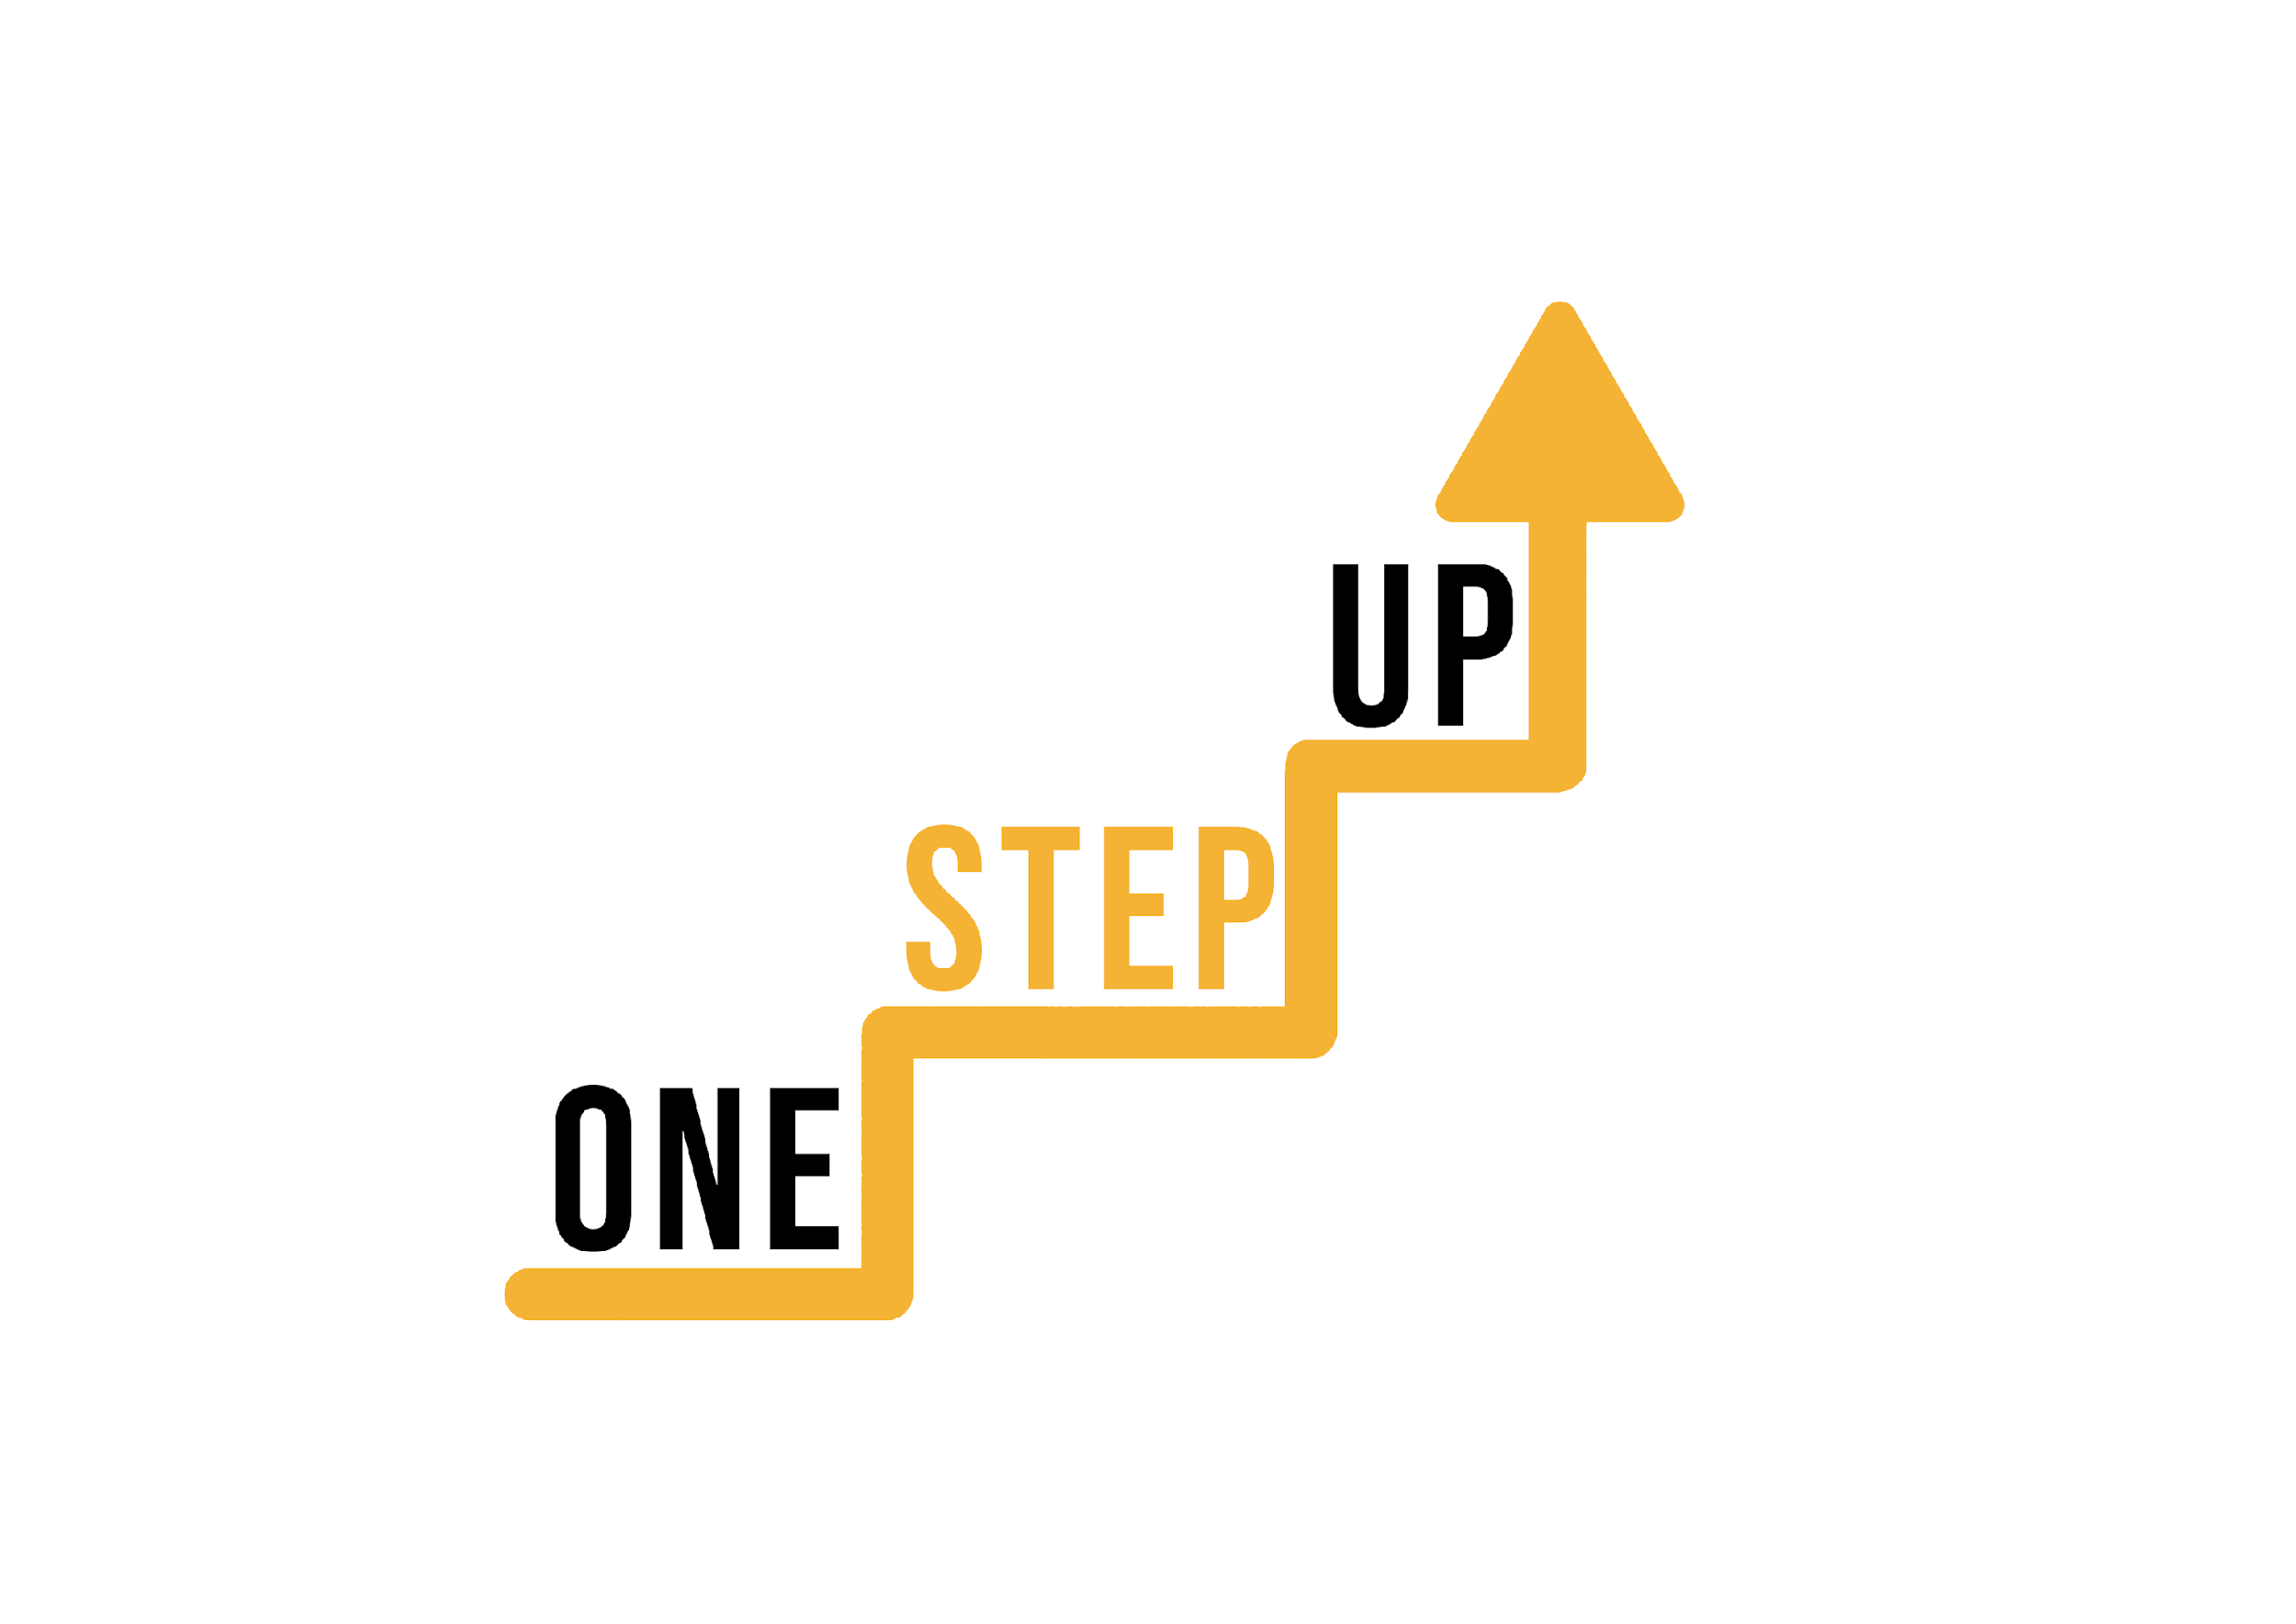
THANK YOU!

Slide 17
“The European Commission’s support of this publication does not constitute an endorsement of the contents, which reflect the views only of the authors, and the Commission can not be held responsible for any use which may be made of the information therein.”
Project Number: 2022-1-LT01-KA220-ADU-000085898

